Slide 1
CREATING LANDMARKS WITH GRC
GFRC FACADES
WHERE DESIGNERS DERAMS TURN INTO REALITY

Slide 2
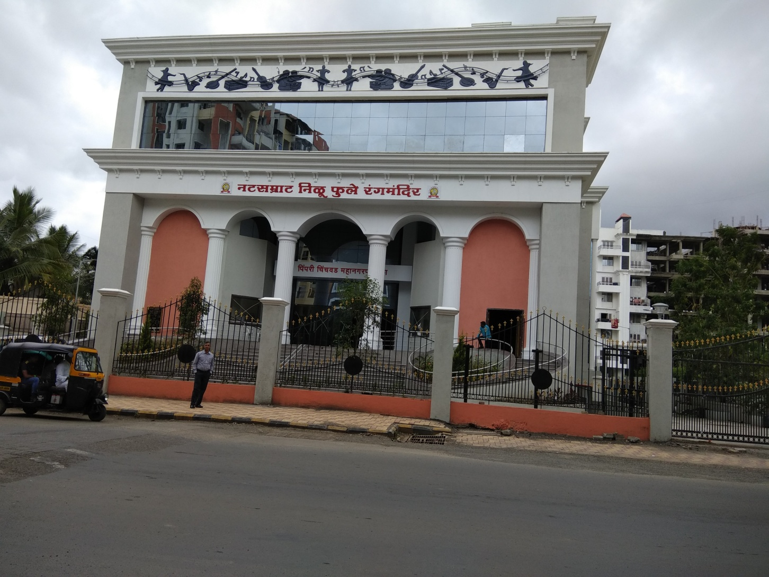
PCMC – NATYA GRUH

Slide 3
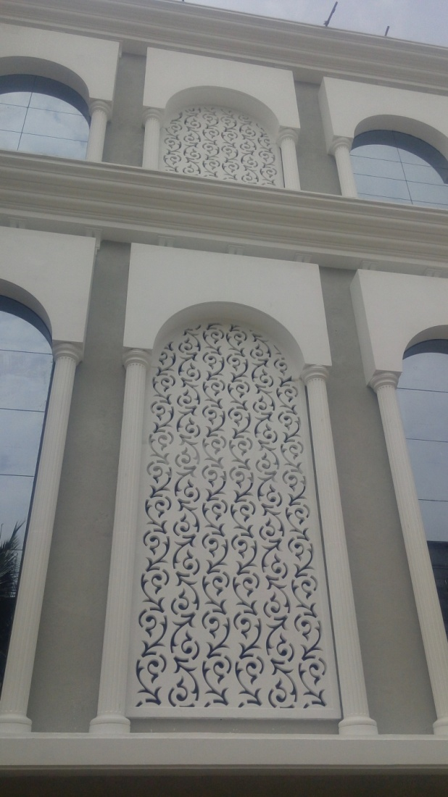
GRC GRILLS
GRILLS IN GRC NOT ONLY PROVIDE THE VERY BASICS OF LIGHT SOURCE ADDED WITH VENTILITATION
BUT ALSO PROVIDE ENCHANTING AESTHETICS AND BRING LIFE TO THE BARE WALLS AROUND.
HERE THE GRILLS HAVE BEEB PLACES WITHIN AN ARCH SUPPORTED BY GRC COLUMNS WITH FLUTES.

Slide 4
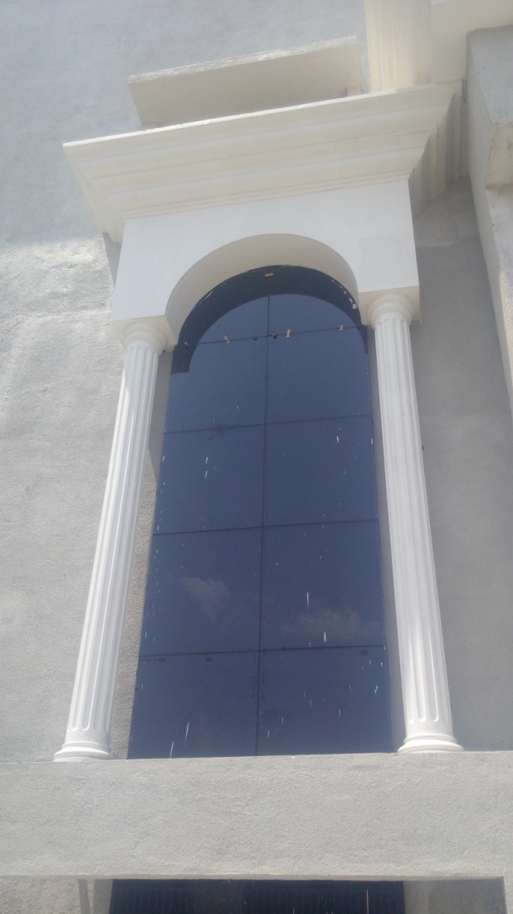
GRC ARCH WITH GLASS
HERE THE TOP CORNICE IS SET UPON THE ARCH WITH THE COLUMNS SUPPORTING THEM.
ARCHES WITH GLASS FOR ENHANCED LIGHTING WITHIN THE AUDITIRIUM CORRIDOORS.
THESE COLUMNS ARE HOLLOW AND SUPPORTED WITH A STEEL TUBE WITHIN, AS GRC COLUMNS ARE NON LOAD BEARING

Slide 5
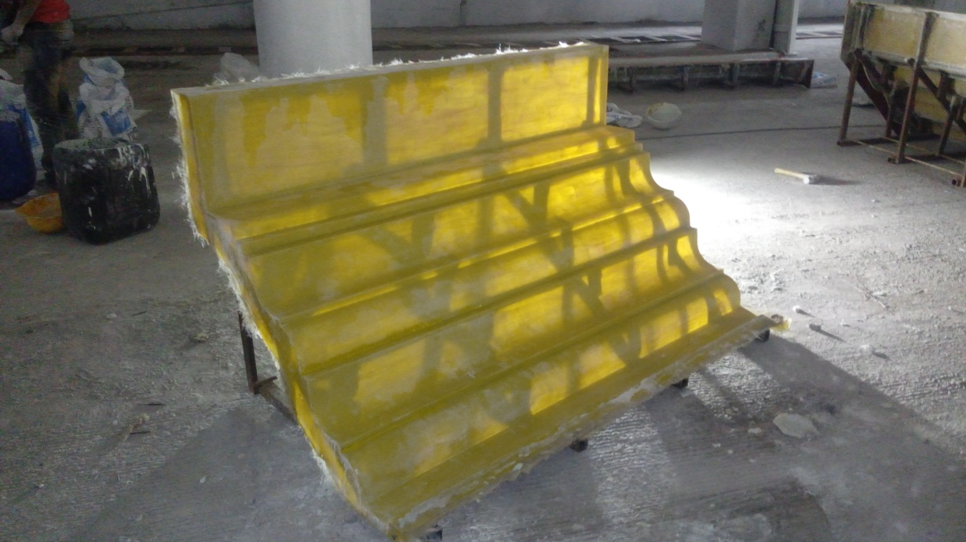
THE CORNICE MOULD
THE MOULDS ARE MADE OF FRP HERE AND COULD ALSO BE MADE OF RUBBER.
RUBBER MOULDS ARE USED USUALLY FOR / WHERE ARCHITECTURAL DETAILS ARE A PART OF THE DESIGN, OR WHERE MAXIMUM REPEATES ARE REQUIRED.
ALSO A ROBUST FRAME SHOULD BE PROVIDED ON THE BACK OF THE MOULD SO THAT THE CASTED MODULE REMAINS INTACT.

Slide 6
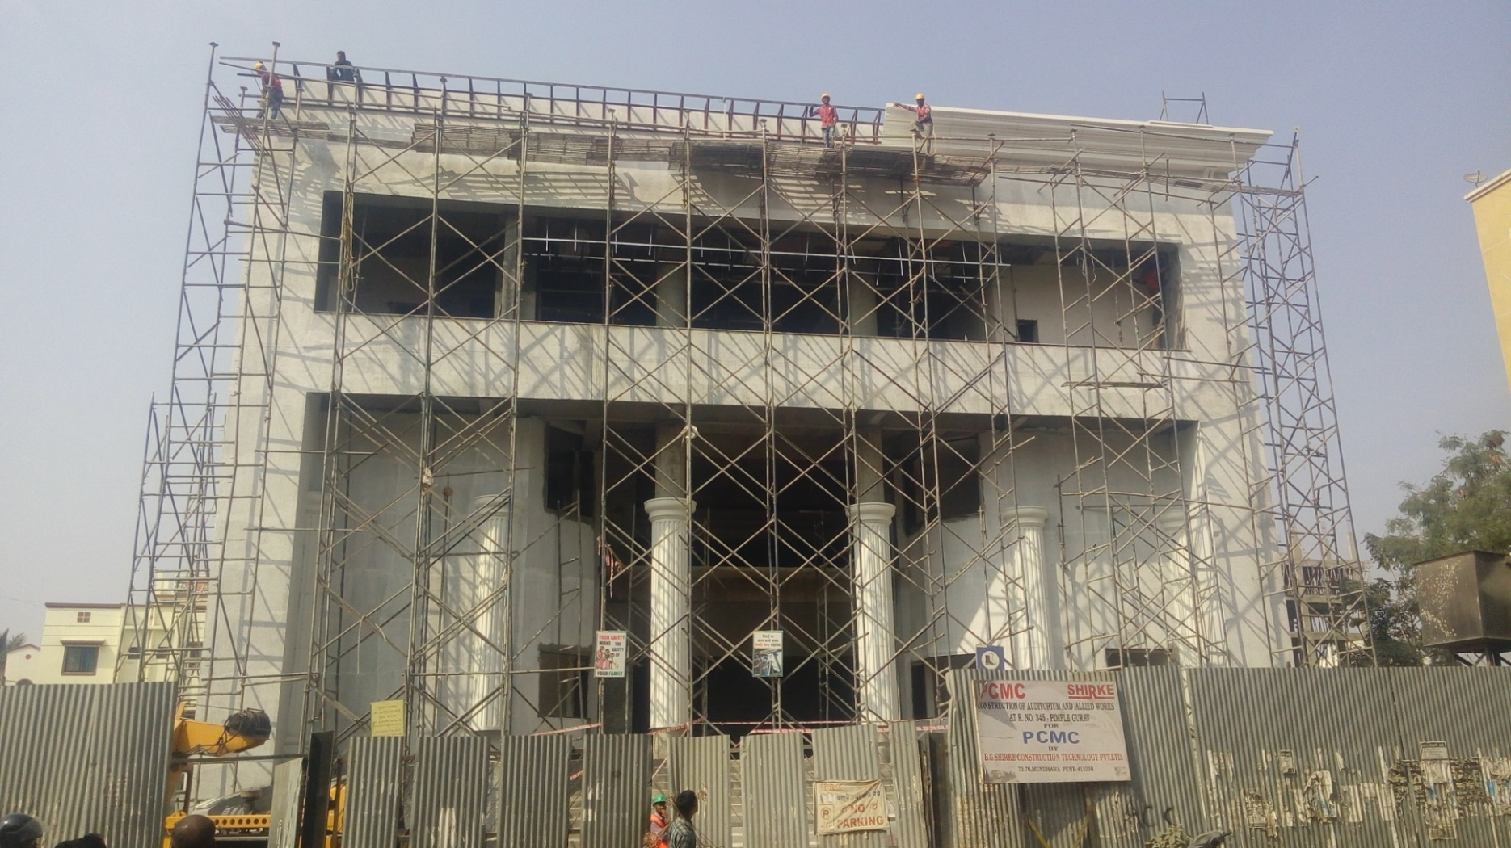
CORNICE STEEL FRAME FOR SUPPORT
THE CORNICE MODULES BEING FIXED ONTO THE STEEL FRAME

Slide 7
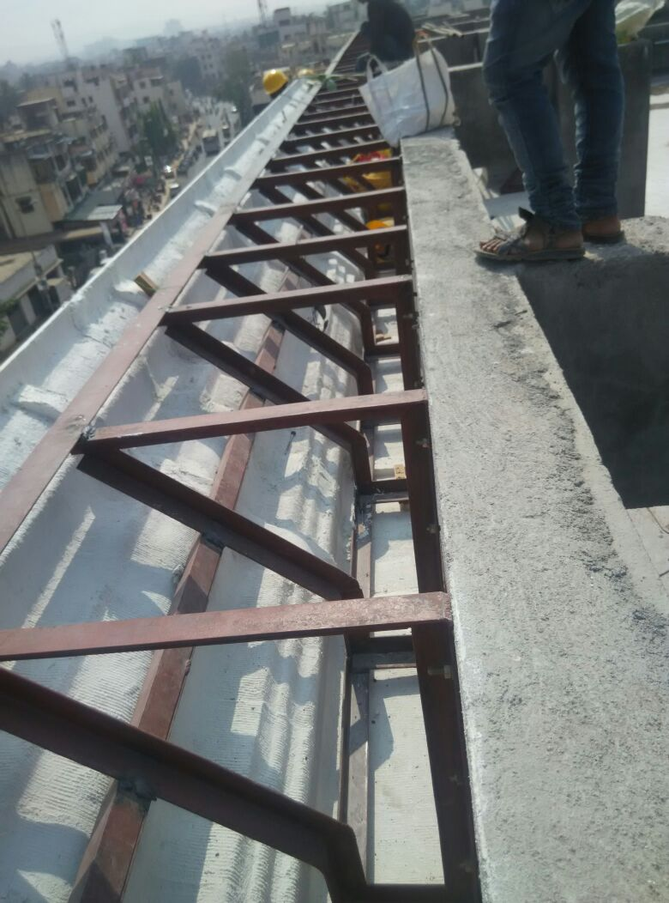
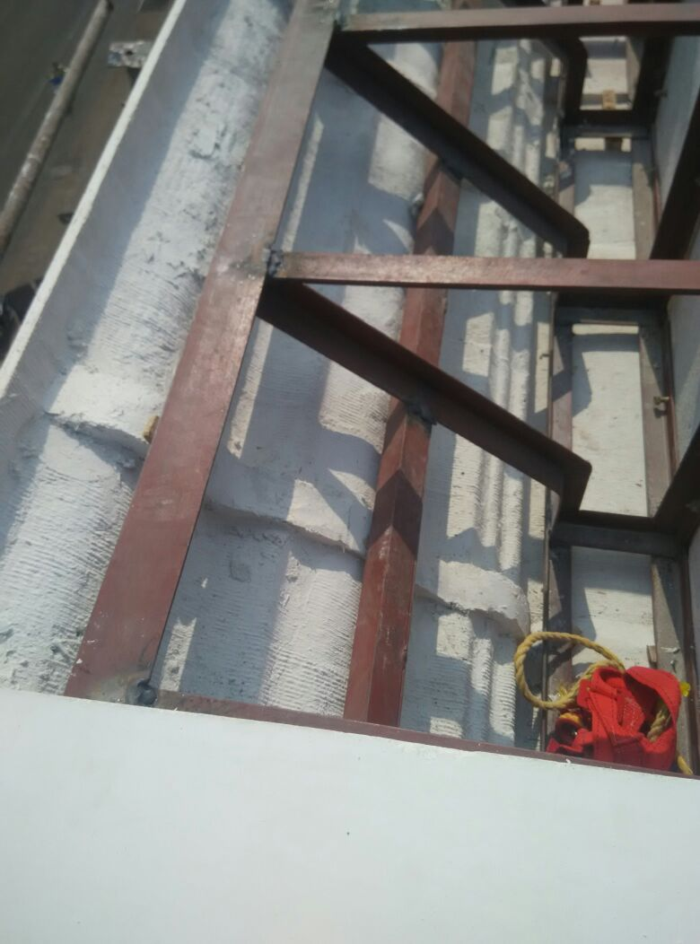
CORNICE FIXING
CORNICES COULD BE FIXED AS SHOWN ON TO STEEL FRAMES & STEEL COULD BE AVOIDED PROVIDED A RCC BEAM AS PROVIDED WITH A THUMB RULE OF -3” FROM GRC FINISHES FACE
STEEL BRACKETS WITH RUNNERS
LINE AND LEVEL TO BE MAINTAINED

Slide 8
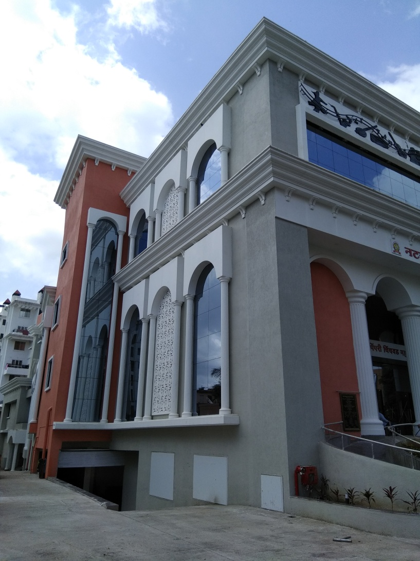
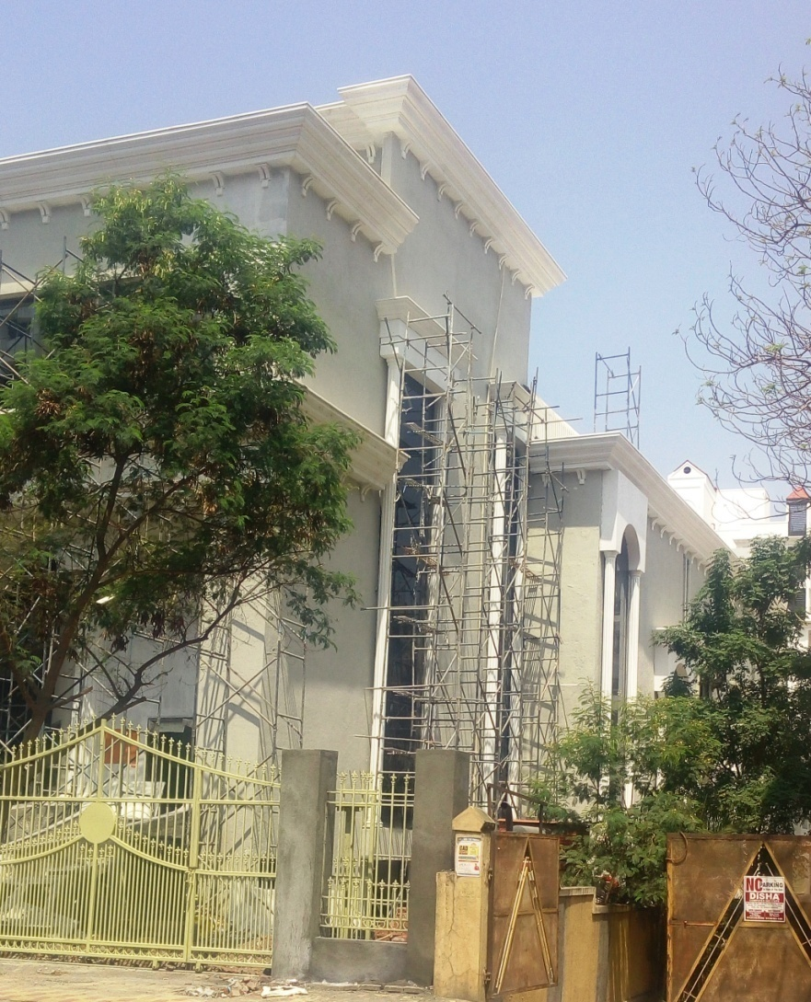
THE VIEW OF SIDE ELEVATIONS

Slide 9
ARCHES SUPPORTED BY HUGE ROUND FLUTED COLUMNS

Slide 10
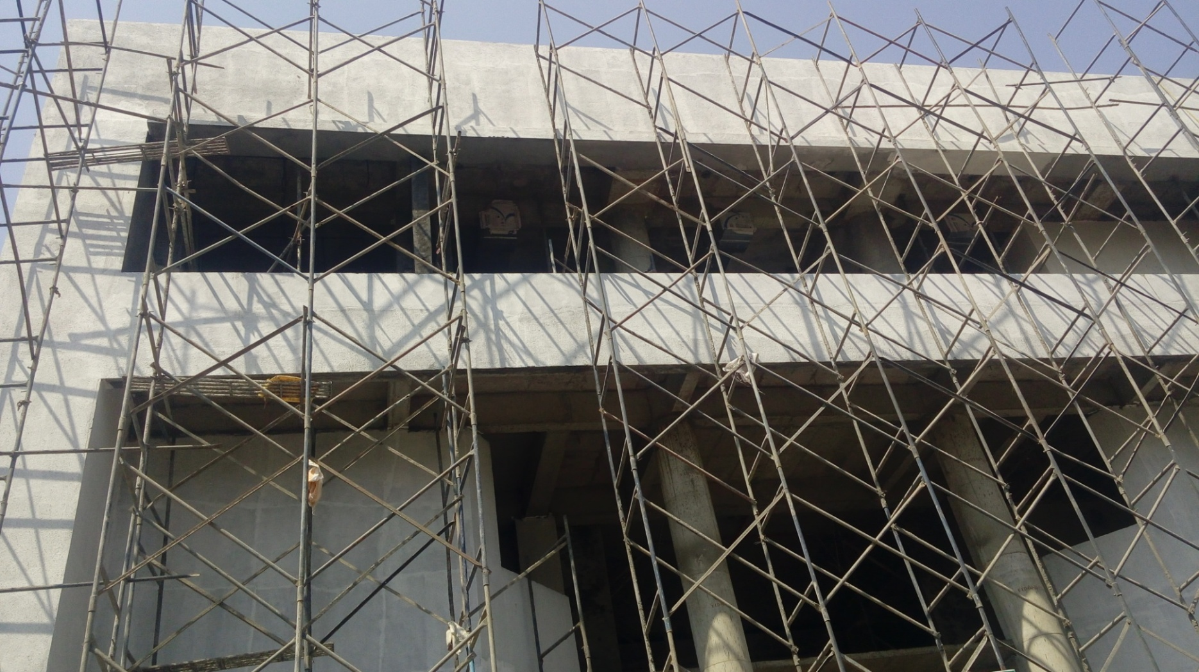
SITE BEFORE GRC DECORATION

Slide 11
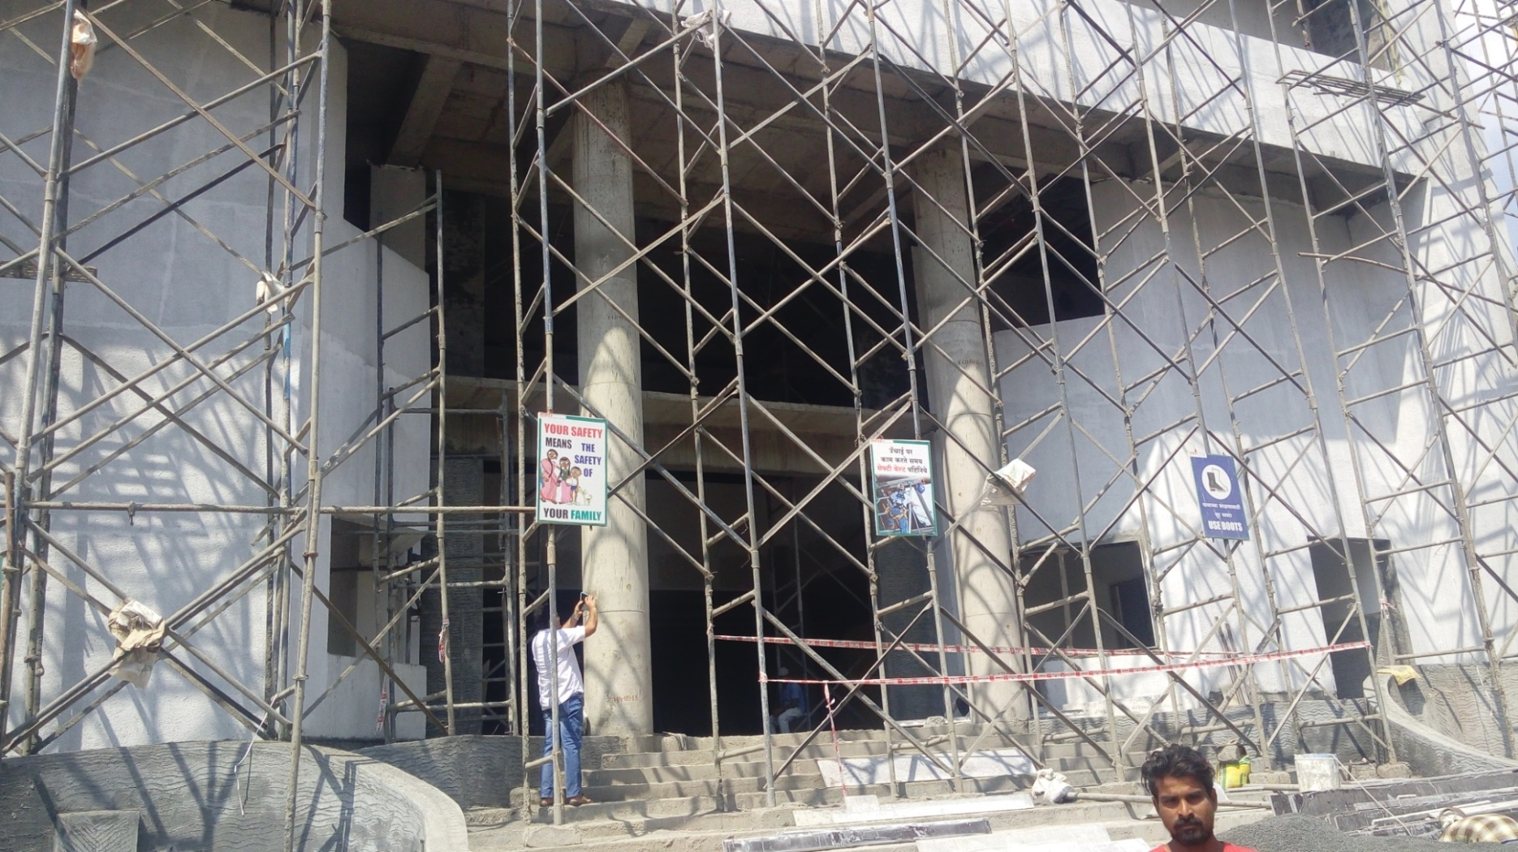
SITE BEFORE GRC DECORATION

Slide 12
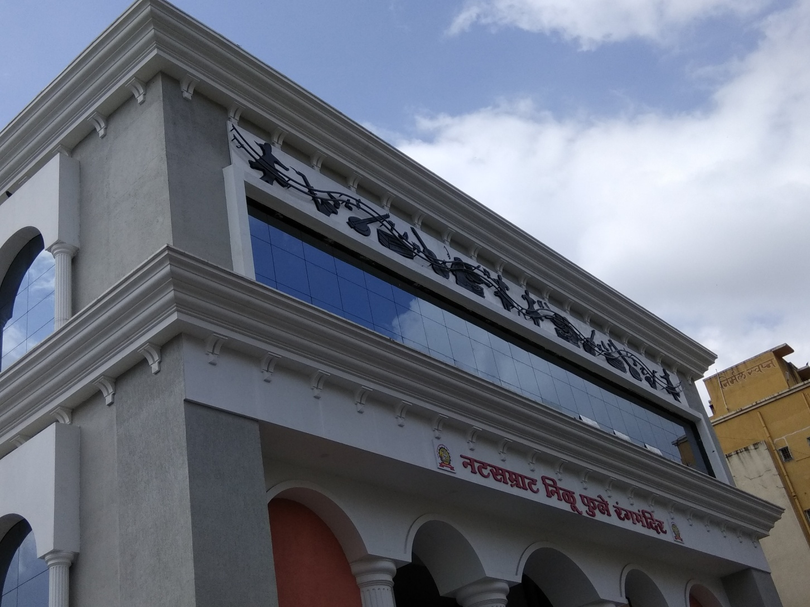
CORNICE WITH BRACKETS
BELOW AS A DECORATIVE FEATURE

Slide 13
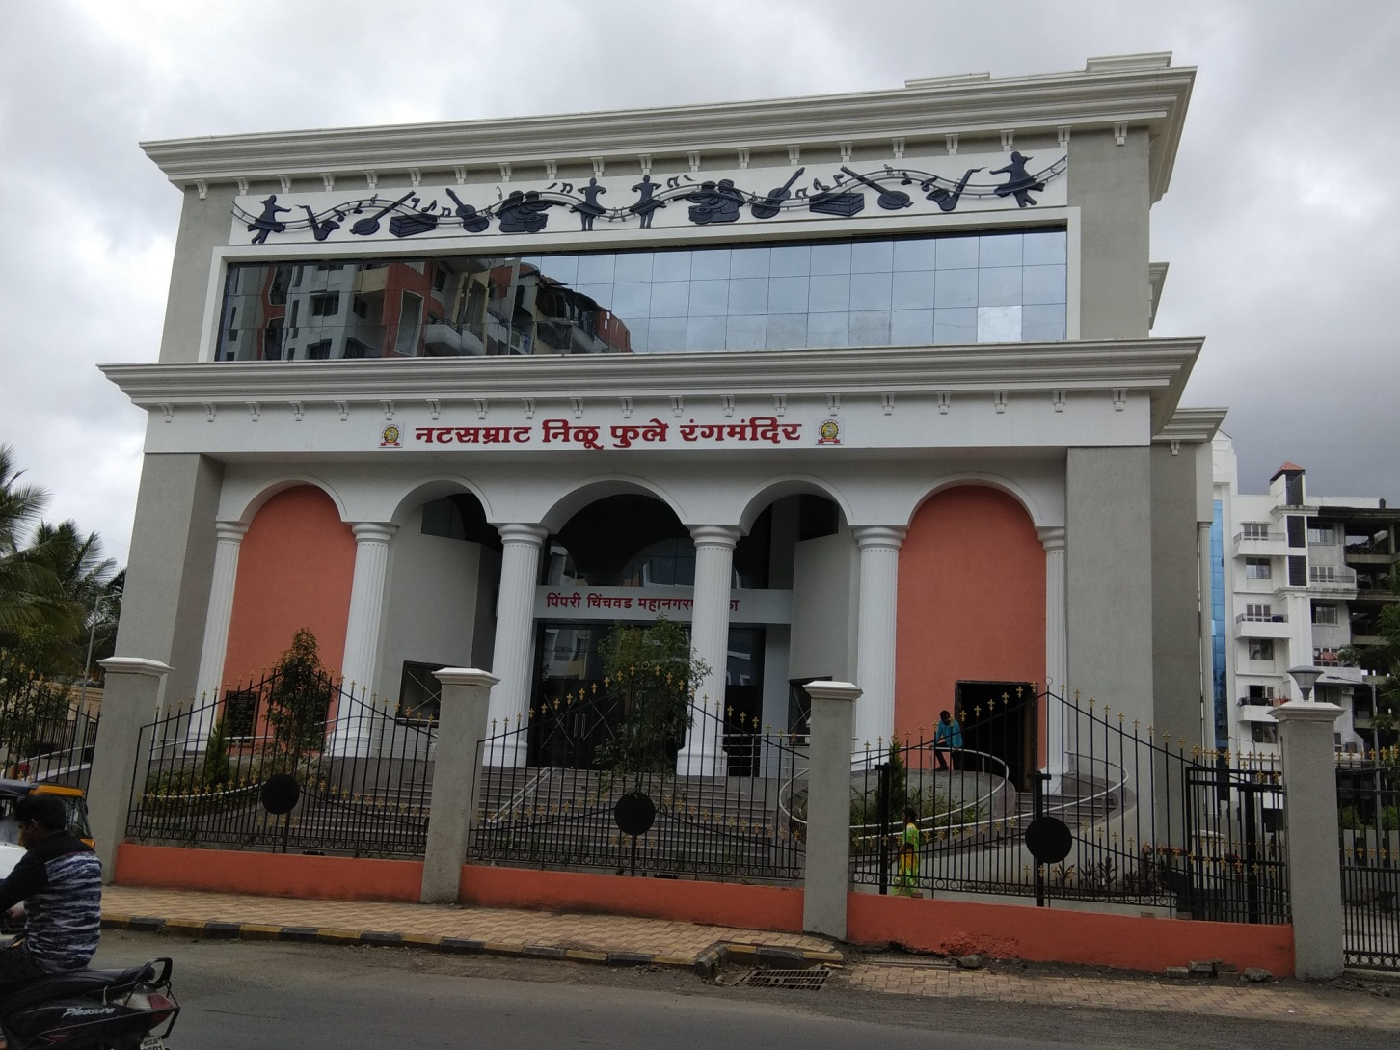
PCMC AUDITORIUM
CREATING LANDMARKS

Slide 14
CONTACT DETAILS
GFRC FACADES.
GFRC / GRC, GRG CEILINGS & PANELS, FRP WORKS, HIGH END DECORATIVE & ARCHITECTURAL WORKS & ACOUSTIC SOLUTIONS WITH EXPERTISE IN HOME THEATRES
SRIHARI NILKAR
MUMBAI
Mobile: 09867569395
nilkarsrihari@gmail.com

